Slide 1
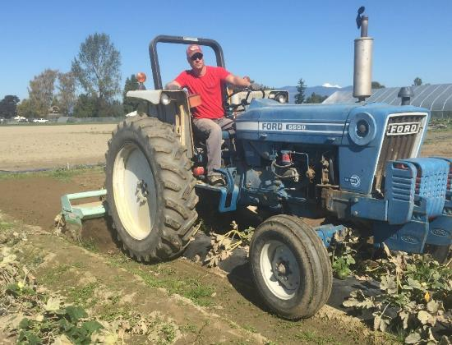
Soil-Biodegradable Plastic Mulch Professional Training
Soil-Biodegradable Mulch for Crop Production
Carol Miles, Washington State University
Shuresh Ghimire, University of Connecticut
biodegradablemulch.org
https://smallfruits.wsu.edu
Notes:
This presentation provides information on the history and rationale for using soil-biodegradable mulch (BDM), its horticultural benefits, application in organic production, and understanding labels.

Slide 2
Alternative to PE Mulch
PE mulch disposal:
Recycling limited due to soil/plant debris contamination
Waste disposal through landfilling and incineration can be limited
Can be a source of environmental pollution
Mulch removal is time and labor consuming
Equipment facilitates mulch removal (e.g. mulch lifter)
Up to 10% mulch reportedly left in the field
Note: BDMs not removable due to ripping
biodegradablemulch.org
https://smallfruits.wsu.edu
Notes:
An alternative to PE (polyethylene) mulch is needed for several reasons. First, the options for PE mulch disposal are limited. PE mulch recycling is limited due to soil and plant debris contamination. Waste disposal through landfilling and incineration can also be limited. PE mulch is a potential source of environmental pollution. Second, mulch removal is time and labor consuming even with equipment designed to facilitate mulch removal (such as a mulch lifter). It is estimated that up to 10% of PE mulch is left in the field. Note that BDMs are not removable due to ripping.

Slide 3
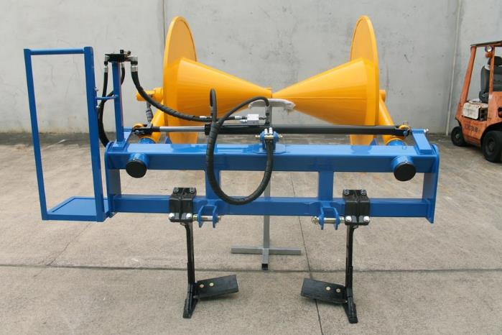
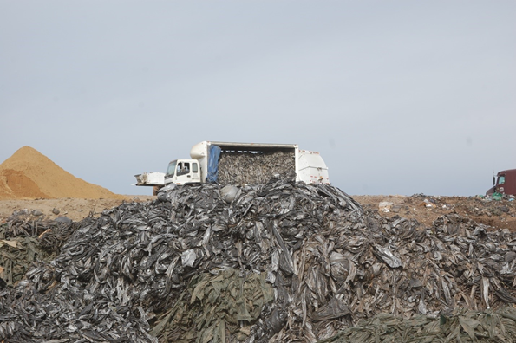
PE Mulch Removal
Mulch Lifter
Mulch Stockpile
Photo: Pam Krone
biodegradablemulch.org
https://smallfruits.wsu.edu
Notes:
This is an example of a mulch lifter (Fig. 1). The amount of PE mulch being stockpiled in California (Fig. 2) is quite extensive as landfill and recycling are not options for disposal.

Slide 4
BDM for Crop Production
BDM should completely biodegrade, not cause harm to soil ecology, and provide:
Weed control
Temperature modification
BDM designed to be tilled into the soil after use, eliminating waste and disposal challenges
BDMs should not go into recycling facilities, they will contaminate recyclate
Soil moisture retention
Comparable yield with PE
biodegradablemulch.org
https://smallfruits.wsu.edu
Notes:
BDM used in crop production should completely biodegrade, without harming the soil ecology. BDM should provide crop production benefits comparable to PE mulch, including weed control, moisture retention, soil temperature modification, efficient use of fertilizer, early harvest, and increased crop yield and quality. BDM is designed to be tilled into the soil after use, eliminating waste and disposal challenges. BDMs should not go into recycling facilities as they will contaminate the other recyclables.

Slide 5
Crop Production with BDM
 | Yield |  | Weed Control
Crop | vs. Bare ground | vs. PE | vs. PE
Broccoli | +¹
Cucumber | + | = | =
Eggplant | + | = | -
Lettuce |  | -=²
Melon | + | += | ≅
Pepper | = | = | -
Raspberry | + | = | =
Strawberry | + | -=+² | -
Sweet Corn | + | -= | -
Sweet Potato | + | += | +
Tomato | + | = | ≅
Zucchini |  | =
¹ + BDM performed better; = BDM performed equivalent to; - BDM did not perform as well; empty cell not measured.
² Reports provide variable results.
Adapted from: Cowan and Miles, 2018
biodegradablemulch.org
https://smallfruits.wsu.edu
Notes:
Crop production with BDMs is shown in Table 1. Yield is greater compared with bare ground and essentially the same as with PE mulch. Weed control varies between BDM and PE mulch depending on crop and location.

Slide 6
USDA National Organic Program
Biodegradable biobased mulch film was added to list of allowed substances on October 2014, but it MUST:
1. Be biobased (ASTM D6866)
2. Be produced without use of non-biobased synthetic polymers; minor additives (colorants, processing aids) not required to be biobased
3. Be produced without organisms or feedstock derived from excluded methods (i.e., synthetic, GMO)
4. Meet compostability specifications (ASTM D6400, ASTM D6868, EN 13432, EN 14995, or ISO 17088)
5. Reach ≥ 90% degradation in soil within 2 years (ISO 17556 or ASTM D5988)
biodegradablemulch.org
https://smallfruits.wsu.edu
Notes:
The USDA National Organic Program added biodegradable biobased mulch film to its list of allowed substances in October 2014. However, it MUST: a) be 100% biobased (ASTM D6866); b) be produced without use of synthetic polymers (minor additives such as colorants and processing aids not required to be biobased); c) be produced without organisms or feedstock derived from excluded methods (i.e., synthetic or GMO); d) meet compostability specifications (ASTM D6400, ASTM D6868, EN 13432, EN 14995, or ISO 17088); and e) reach ≥ 90% degradation in soil within 2 years (ISO 17556 or ASTM D5988).

Slide 7
GMOs in BDM
GMOs commonly used in the manufacture of BDM:
Feedstocks, such as starch: corn, sugar beet
Fermentation of feedstocks: bacteria, yeast
Minor additives
Difficult to determine GMO status of end product:
Source of feedstocks not disclosed
DNA degraded after fermentation and processing, thus not measurable
No plastic BDMs approved for use in certified organic production
Paper BDM is allowed (WeedGuardPlusTM)
biodegradablemulch.org
https://smallfruits.wsu.edu
Notes:
GMOs are commonly used in the manufacture of BDM. For example, starch (corn, sugar beet) feedstocks are fermented by GM bacteria or yeast. It is difficult to determine the GMO status of the end product when the source of feedstocks is not disclosed, or when DNA is degraded after fermentation and processing and is thus not measurable. NO plastic BDMs are approved for use in certified organic production. Paper BDM (such as WeedGuardPlusTM) is allowed for organic production.

Slide 8
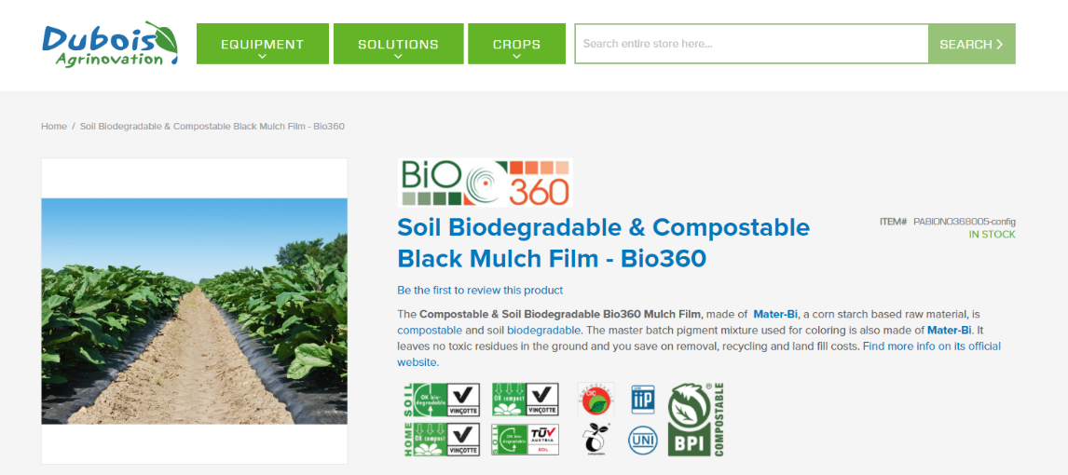
What Does the Label Tell You?
biodegradablemulch.org
https://smallfruits.wsu.edu
Notes:
What does the label tell you? If biodegradability test results are not included in the product label, then it should be assumed that the product does not meet the standards.

Slide 9
Resources
Biodegradable Mulch Film for Organic Production Systems https://ag.tennessee.edu/biodegradablemulch/Documents/BDM_for_organic_production_rev_5Apr2016.pdf
Biodegradable Plastic Mulch and Suitability for Sustainable and Organic Agriculture http://pubs.cahnrs.wsu.edu/publications/pubs/fs103e/
Biodegradable Mulch Products https://ag.tennessee.edu/biodegradablemulch/Pages/biomulchprojects.aspx
Glossary of terms associated with biodegradable mulches for specialty crops https://ag.tennessee.edu/biodegradablemulch/Documents/BDM_glossary_May2015.pdf
Impact of Biodegradable Plastic Mulch on Specialty Crop Production https://ag.tennessee.edu/biodegradablemulch/Documents/BDM%20for%20crops-research%20summary.pdf
Video - An Introduction to "Performance and Adoptability of Biodegradable Plastic Mulch for Sustainable Specialty Crop Production https://www.youtube.com/embed/B1GGXN1d0aw
Video - Biodegradable much: a grower's experience of general benefits and disadvantages https://www.youtube.com/watch?v=kyvB1QxHAtE&list=PLuPJ_NR7ZnVuPh7t7erYYXcVw-h4xg0Xm
biodegradablemulch.org
https://smallfruits.wsu.edu

