Slide 1
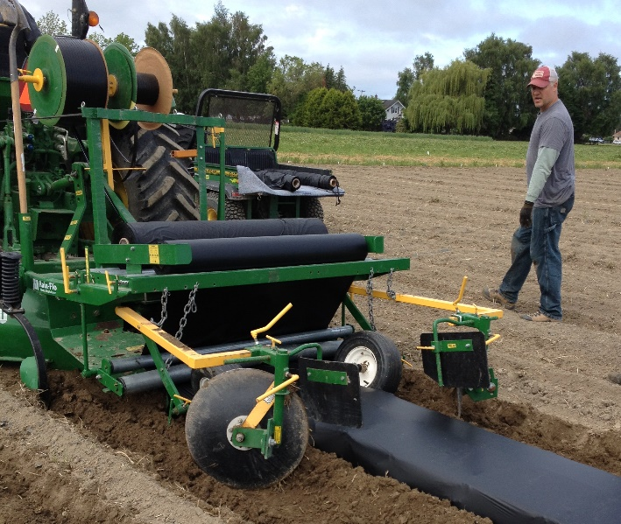
Soil-Biodegradable Plastic Mulch Professional Training
Applying Soil-Biodegradable Mulch
Lisa DeVetter and Huan Zhang, Washington State University
Mark Bolda, University of California
biodegradablemulch.org
https://smallfruits.wsu.edu
Notes:
This presentation provides information on the methods used in applying BDMs with a mechanical mulch layer on either raised or flat planting beds.

Slide 2
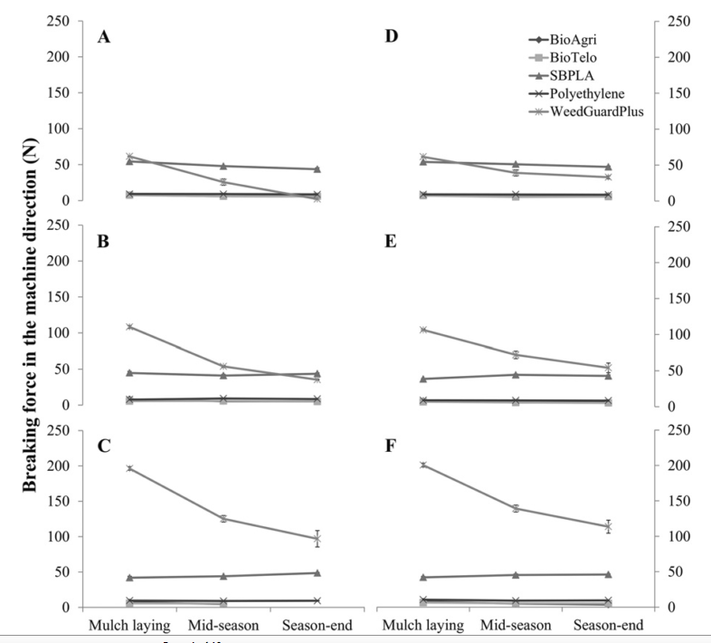
PE vs. BDM
BDM usually thinner to reduce cost, and to achieve the targeted biodegradation
Mechanical strength
Elongation
Breaking force
Spilt force
Lower for BDM than PE
Breaking force (N) in the machine direction (BF-M) of five mulch treatments (BioAgri, BioTelo, SBPLA, polyethylene, and WeedGuardPlus) in (A–C) open field and (D–F) high tunnel tomato production systems at Mount Vernon, WA, during (A and D) 2010, (B and E) 2011, and (C and F) 2012 summer growing seasons. Error bars represent the standard error of the mean.
Cowan et al., 2016
biodegradablemulch.org
https://smallfruits.wsu.edu
Notes:
BDMs are usually thinner than PE (polyethylene) mulch. Reducing the thickness of BDM reduces their cost. Mechanical strength, measured as elongation, breaking force and split force are greater for PE than BDM (Fig. 1).

Slide 3
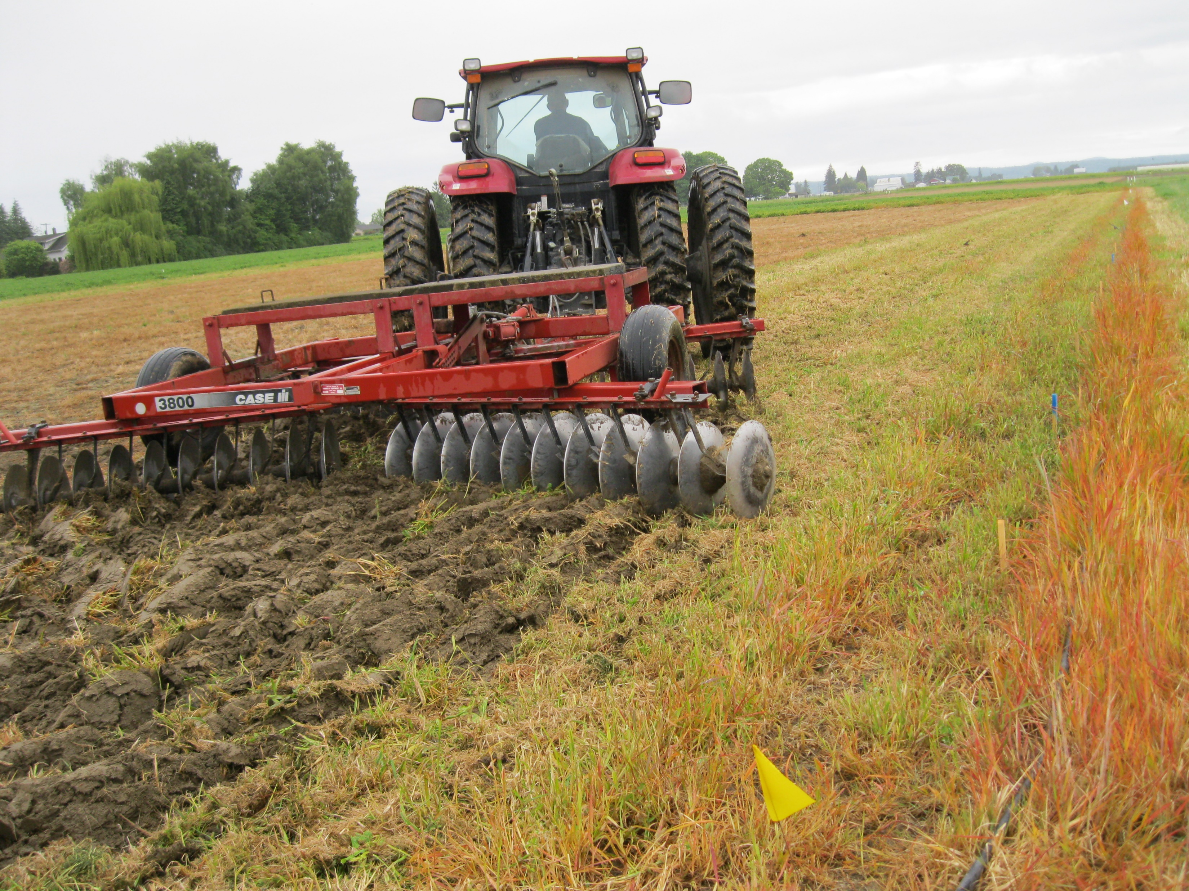
Prepare Bed for Mulch Laying
Till soil
Broadcast fertilizer (if using)
Lay mulch when soil conditions are conducive
Moisture
Free of clods
biodegradablemulch.org
https://smallfruits.wsu.edu
Notes:
Preparing the bed for mulch laying requires several steps: a) till the soil; b) broadcast fertilizer if using; and c) lay mulch when soil conditions are conducive, that is, when soil is moist and free of clods.

Slide 4
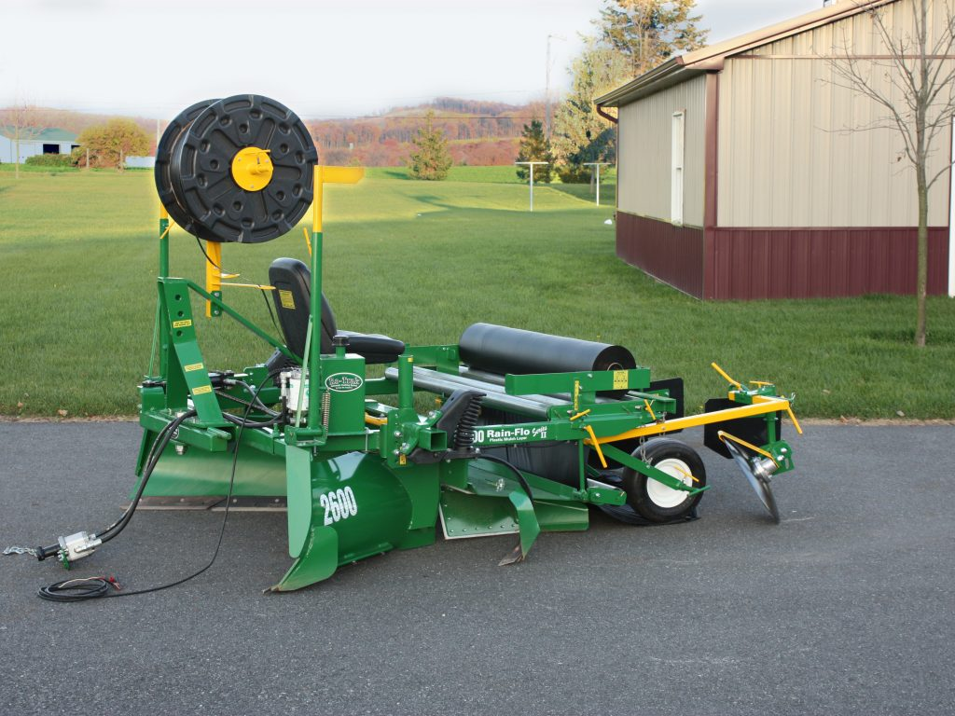
Example Mulch Layer
Mulch Roller
Drip Tape
Mulch and drip tape can be laid simultaneously
Mulch ≤ 5 ft width
Bed dimension and tension on mulch are adjustable
Ghimire, et al., 2017; Rain-Flo
biodegradablemulch.org
https://smallfruits.wsu.edu
Notes:
Mulch and drip tape can be laid simultaneously (Fig. 2). Mulch is usually 3—5 ft in width; bed width and height are adjustable; release the tension on the roller bars that press down on the mulch before applying.

Slide 5
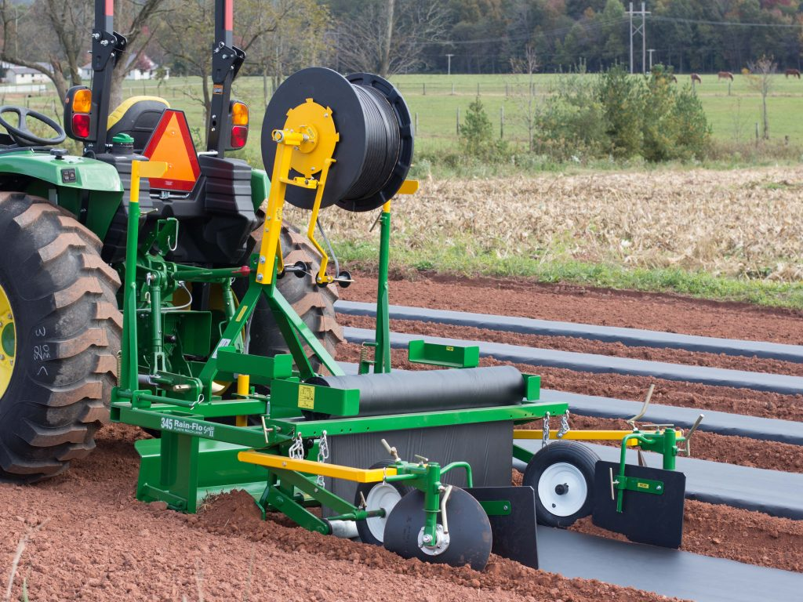
Flat Bed Mulch Layer
Rain-Flo
biodegradablemulch.org
https://smallfruits.wsu.edu
Notes:
Mulch layers can be flat-bed (Fig. 3)

Slide 6
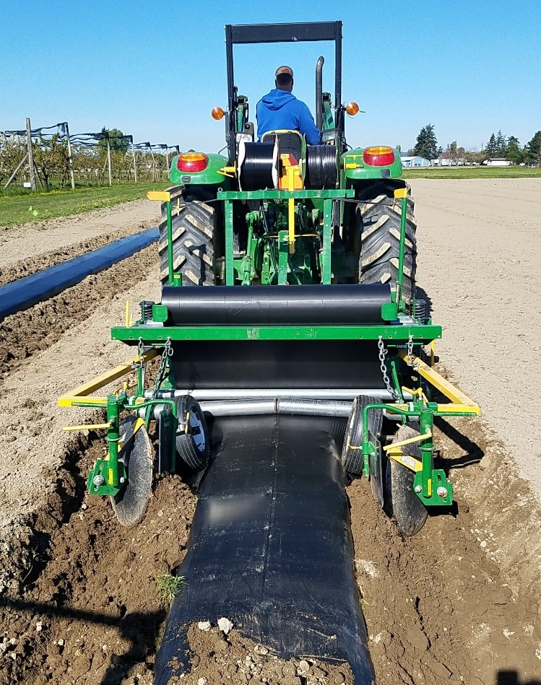
Raised Bed Mulch Layer
Rain-Flo
biodegradablemulch.org
https://smallfruits.wsu.edu
Notes:
Raised bed (Fig. 4)

Slide 7
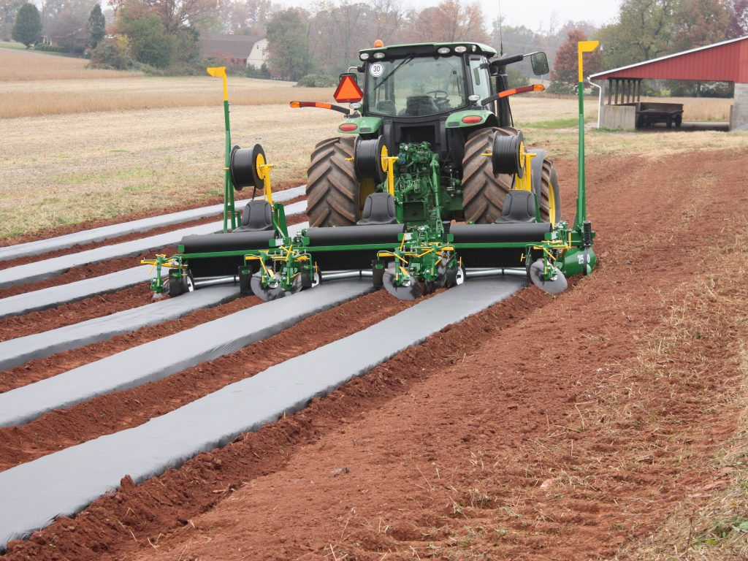
Multiple Bed Mulch Layer
Rain-Flo
biodegradablemulch.org
https://smallfruits.wsu.edu
Notes:
Or multiple beds wide as in this 3-row layer (Fig. 5).

Slide 8
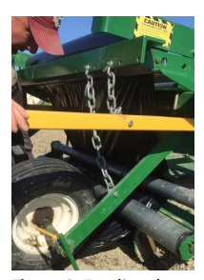
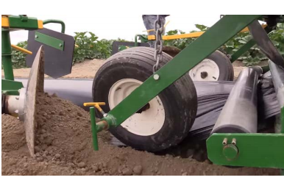
Mulch Laying
Feed mulch through roller bar
Adjust tension so mulch can easily roll
Pull mulch under guide wheels
Wheel should rest slightly on mulch or float just above
Ghimire et al., 2017
biodegradablemulch.org
https://smallfruits.wsu.edu
Notes:
The procedure for mulch laying is similar for all mulch layers. First feed the end of the mulch roll through the roller bar and reduce the tension so it can roll easily (Fig. 6). Pull the mulch under the guide wheels; the wheel(s) should rest lightly on the mulch or float just above it (Fig. 7).

Slide 9
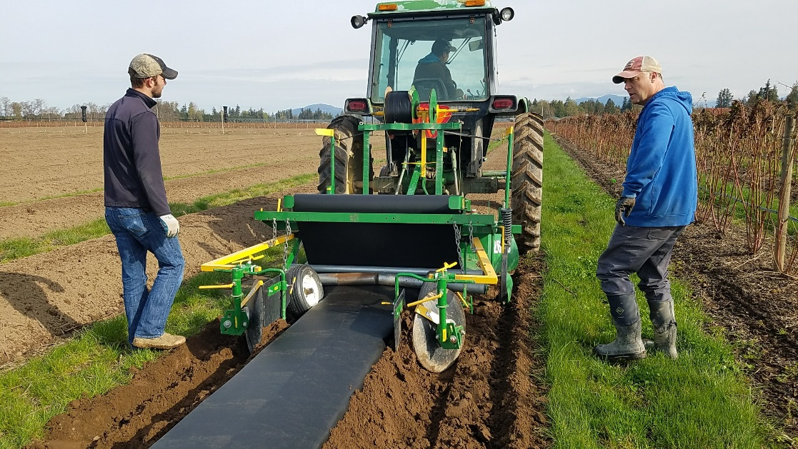
Mulch Laying
Stabilize and place drip tape in desired location
Shovel soil at end of row and on sides of wheels
Secure the drip tape at the end of row
Ghimire et al., 2017
biodegradablemulch.org
https://smallfruits.wsu.edu
Notes:
Place the drip tape roll in the desired location (i.e. center of bed) and secure the roll. Shovel soil onto the end of the mulch at the end of the bed and on the sides under the wheel to keep the mulch in place before pulling it. Secure the drip tape at the end of the row.

Slide 10
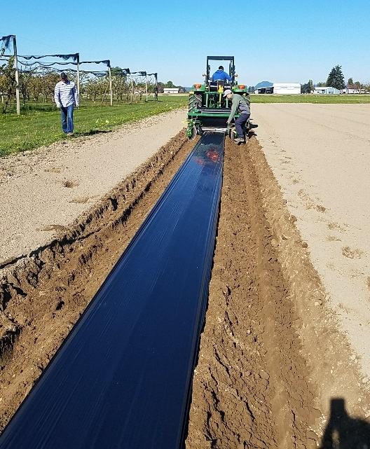
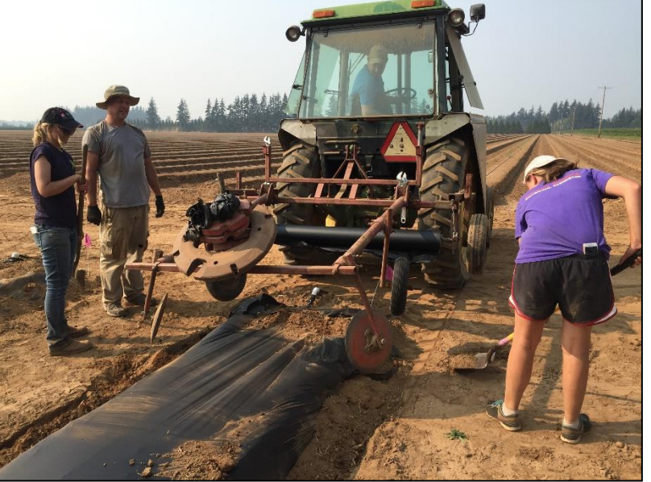
Mulch Laying
Slowly drive forward then increase speed, laying speed same as for PE
After laying a row
Cut mulch at the end
Cut drip tape
What if mulch tears in the middle of laying a row?
Cover the rip with soil
If the rip is across the bed, stop laying the mulch, pull the mulch off the roll to overlap about 1 foot with the mulch on the bed, and continue laying
Secure at end of row by covering mulch with soil
Ghimire et al., 2017
biodegradablemulch.org
https://smallfruits.wsu.edu
Notes:
Slowly drive the tractor forward, gradually increasing the speed. After laying a row, cut off the mulch from the roll and cut the drip tape. Secure the mulch at the end of the row by covering the mulch with soil (Fig. 8). If the mulch tears in the middle of laying a row, cover the rip with soil. Or if the ripping is across the bed, stop laying the mulch, pull the mulch off the roll to overlap about 1 foot with the mulch on the bed, and continue laying.

Slide 11
Mulch Requirement
Length (ft.) of mulch needed per acre based on bed spacing (ft, center-to-center)
Bed spacing (center-to-center) | Production Area
 | 1 acre | 3 acres | 5 acres | 10 acres
5 ft | 8,712 | 26,136 | 43,560 | 87,120
6 ft | 7,260 | 21,780 | 36,300 | 72,600
7 ft | 6,223 | 18,669 | 31,115 | 62,230
8 ft | 5,445 | 16,335 | 27,225 | 54,450
Ghimire and Miles, 2016
biodegradablemulch.org
https://smallfruits.wsu.edu
Notes:
This (Table 1) shows the length of mulch needed for different production areas based on bed spacing.

Slide 12
Resources
Cowan, J., A. Saxton, H. Liu, K.K. Leonas, D.A. Inglis, and C.A. Miles. 2016. Visual assessments of biodegradable mulch deterioration are not indicative of changes in mechanical properties. HortScience 51(3):245-254.
Dimensions And Costs Of Biodegradable Plastic And Polyethylene Mulches http://vegetables.wsu.edu/Dimensions%20%26%20costs%20plastic%20and%20biodegradable%20mulch.pdf
Dimensions and Costs of Biodegradable Plastic and Polyethylene Mulches https://s3.wp.wsu.edu/uploads/sites/2181/2017/06/FactSheet.CostandDimensions-2.pdf
Mechanically Laying Biodegradable Paper And Plastic Mulch http://vegetables.wsu.edu/Laying%20BDM.pdf
Mechanically Laying Mulches In Tissue Culture Raspberry https://s3.wp.wsu.edu/uploads/sites/2181/2017/06/WSU-Fact-Sheet-Mechanically-Laying-Mulches-in-Tissue-Culture-Raspberry.pdf
Video - A Guide To Laying And Tilling In Of Biodegradable Mulch https://www.youtube.com/watch?v=aMjD4vbr9eA&feature=youtu.be
biodegradablemulch.org
https://smallfruits.wsu.edu

